Slide 1
Front End Web Development
Topic 2:
Introduction to HTML5
Notes:
NCC Education - Title Master

Slide 2
Scope and Coverage
This topic will cover:
HTML
Role of HTML
HTML Document Structure
Text-level Elements
HTML Lists
HTML Forms
HTML Best Practices
Notes:
NCC Education - Slide Master

Slide 3
Learning Outcomes
By the end of this topic students will be able to:
Describe the use of HTML for website development
Understand the basics of HTML5
Explain the HTML structure
Demonstrate understanding of HTML basics

Slide 4
Unit Roadmap
Week | Topic | Week | Topic
1 | Overview of Web Application Architecture | 7 | JavaScript - II
2 | Introduction to HTML5 | 8 | jQuery
3 | Introduction to CSS | 9 | Responsive CSS Framework: Bootstrap -I
4 | HTML and CSS | 10 | Responsive CSS Framework: Bootstrap -II
5 | CSS Flexbox and Grid Layout | 11 | Code Review, Testing and Collaboration
6 | JavaScript - I | 12 | Unit Summary

Slide 5

HTML

Slide 6

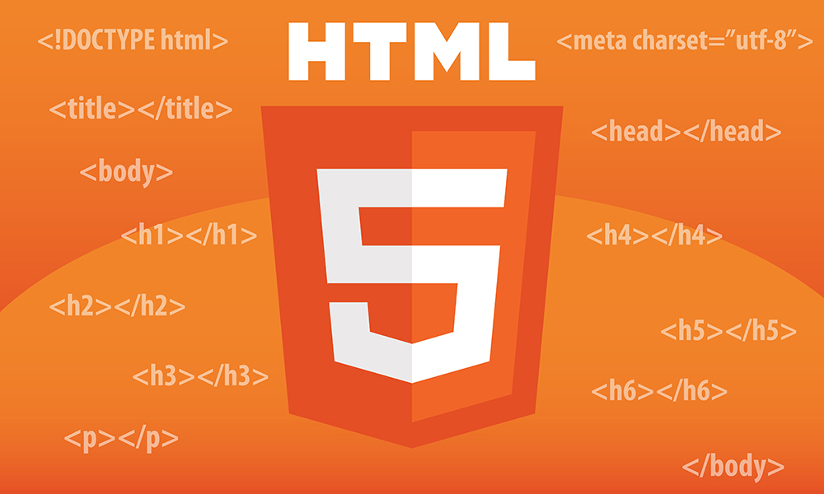
HTML
HTML stands for HyperText Markup Language.
It is the standard markup language used for creating and structuring web pages and web applications.
HTML uses various elements and tags to define the content and layout of a webpage.
What is hypertext?
What is markup language?

Slide 7
HTML Code Example
<!DOCTYPE html>
<html>
<head>
<title>My First Web Page</title>
</head>
<body>
<h1>Welcome to My Website</h1>
<p>This is the first paragraph of my webpage.</p>
<img src="example.jpg" alt="Example Image">
<a href="https://www.example.com">Visit Example Website</a>
</body>
</html>

Slide 8
Roles of HTML (1)
Foundation of Web Development:
building block of web development
structure and content for web pages
Universal Language:
supported by all web browsers and cross-platform compatibility
Accessibility:
improved user experience
accessible to people with disabilities
Structure:
basic structure of a webpage
defines headings, paragraphs, lists, and other content blocks

Slide 9
Roles of HTML (2)
Text Formatting:
control the appearance of text, such as font styles, colors, and sizes
Hyperlinks:
create hyperlinks to navigate between pages and resources on the web
Images and Media:
allows embedding of images, videos, and audio on web pages
Forms:
elements to enable user interaction, such as receiving user input and data
Semantic Markup:
semantic elements that add meaning to the content, aiding search engines and accessibility

Slide 10
HTML Document Structure
<!DOCTYPE html>
<html>
<head>
<title>My First Web Page</title>
</head>
<body>
<h1>Welcome to My Website</h1>
<p>This is the first paragraph of my webpage.</p>
<img src="example.jpg" alt="Example Image">
<a href="https://www.example.com">Visit Example Website</a>
</body>
</html>
HTML follow a specific structure.
Structure defines how the content of a webpage is organised and displayed.
Necessary to create well-formed and valid web pages.
Basic structure of an HTML document consists of several elements, each serving a specific purpose.

Slide 11
HTML Document Structure
Document Type Declaration (<!DOCTYPE html>)
The document type declaration (DTD) specifies the version of HTML to the browser.
For HTML5 - <!DOCTYPE html> indicates that the document is written in HTML5.
<!DOCTYPE html>
<html>
<head>
<title>My First Web Page</title>
</head>
<body>
<h1>Welcome to My Website</h1>
<p>This is the first paragraph of my webpage.</p>
<img src="example.jpg" alt="Example Image">
<a href="https://www.example.com">Visit Example Website</a>
</body>
</html>

Slide 12
HTML Document Structure
<html> Element:
The <html> element is the root element in HTML.
It encapsulates all other elements of the webpage.
Every HTML document starts and ends with this element.
<!DOCTYPE html>
<html>
<head>
<title>My First Web Page</title>
</head>
<body>
<h1>Welcome to My Website</h1>
<p>This is the first paragraph of my webpage.</p>
<img src="example.jpg" alt="Example Image">
<a href="https://www.example.com">Visit Example Website</a>
</body>
</html>

Slide 13
HTML Document Structure
<head> Element:
Contains meta-information about the webpage.
Produces no visible content, provides important details to browsers and search engines.
Common elements found inside the <head> element include:
<title>: Sets the title of the webpage, which appears in the browser's title bar or tab.
<meta>: Defines meta-information, such as character encoding and viewport settings.
<link>: Imports external resources like stylesheets and favicons.
<script>: Includes JavaScript files or code.
<!DOCTYPE html>
<html>
<head>
<title>My First Web Page</title>
</head>
<body>
<h1>Welcome to My Website</h1>
<p>This is the first paragraph of my webpage.</p>
<img src="example.jpg" alt="Example Image">
<a href="https://www.example.com">Visit Example Website</a>
</body>
</html>

Slide 14
HTML Document Structure
<body> Element:
Consists the visible content of the webpage that is to be displayed on the webpage on browser.
Content such as text, images, multimedia, and interactive elements are declared within the <body> element.
All the content that users see on the webpage should be placed inside this element.
<!DOCTYPE html>
<html>
<head>
<title>My First Web Page</title>
</head>
<body>
<h1>Welcome to My Website</h1>
<p>This is the first paragraph of my webpage.</p>
<img src="example.jpg" alt="Example Image">
<a href="https://www.example.com">Visit Example Website</a>
</body>
</html>

Slide 15
HTML Document Structure
Structural Element:
Defines the layout and organisation of the content within the <body> element.
Examples:
<header>: Represents the introductory content at the top of a webpage, often containing logos and navigation menus.
<nav>: Represents a section containing navigation links.
<main>: Encloses the main content of the webpage.
<article>: Defines a self-contained piece of content, like a blog post or article.
<section>: Represents a thematic grouping of content within an article or webpage.
<aside>: Represents content that is tangentially related to the main content, such as sidebars or widgets.
<footer>: Contains footer information, typically found at the bottom of the webpage.

Slide 16

HTML Text Level Elements

Slide 17
Text-level Elements
Text-level elements in HTML are used to structure and format the text content within a web page.
Allows application of specific meanings and styles to different parts of the text.
Effective use of these elements:
Improves the accessibility of webpage
Helps with search engine optimization (SEO)
Provides a more meaningful user experience
Commonly used text-level elements are described in following slides.

Slide 18
Text-level Elements
<h1> to <h6> (Headings):
These elements represent hierarchical headings, ranging from the most important <h1> to the least important <h6>.
Headings define the sections and sub-sections of a webpage.
Allows content organisation and improves readability.

Slide 19
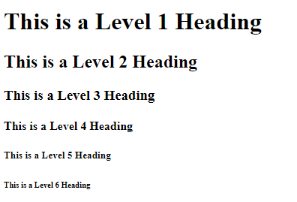
Text-level Elements: h1 – h6 example
<!DOCTYPE html>
<html>
<head>
<title>My First Web Page</title>
</head>
<body>
<h1>This is a Level 1 Heading</h1>
<h2>This is a Level 2 Heading</h2>
<h3>This is a Level 3 Heading</h3>
<h4>This is a Level 4 Heading</h4>
<h5>This is a Level 5 Heading</h5>
<h6>This is a Level 6 Heading</h6>
</body>
</html>

Slide 20

Text-level Elements
<p> (Paragraphs):
The <p> element defines a paragraph.
It allows grouping together blocks of text.
Browsers add space before and after paragraphs to visually separate them.
<!DOCTYPE html>
<html>
<head>
<title>My First Web Page</title>
</head>
<body>
<p>This is a paragraph. It contains multiple sentences and forms a coherent block of text.</p>
<p> This is second paragraph.</p>
</body>
</html>

Slide 21

Text-level Elements
<a> (Links):
The <a> element creates hyperlinks.
Allows users to navigate to other web pages or resources.
The href attribute specifies the destination URL of the link.
<body>
<p>Check out my <a href="https://www.example.com">website</a> for more information.</p>
</body>

Slide 22

Text-level Elements
<strong> and <em> (Emphasis):
<strong> represents strong emphasis, often displayed as bold text by browsers.
<em> represents emphasised text, typically displayed in italics by browsers.
These elements add semantic meaning to the text, helping search engines and assistive technologies.
<body>
<p><strong>Important:</strong> Please read the instructions carefully.</p>
<p>This quote is <em>very</em> inspiring.</p>
</body>

Slide 23

Text-level Elements
<span> (Inline Container):
The <span> element is an inline container.
Allows to apply styles or add semantics to a specific section of text.
Unlike block-level elements, <span> does not add line breaks before and after its content.
<body>
<p>My bag is <span style="color:red">red</span> colour.</p>
</body>

Slide 24
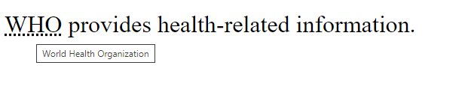
Text-level Elements
<abbr> (Abbreviation):
The <abbr> element represents an abbreviation or acronym.
Provides an additional information through a title attribute.
<body>
<p><abbr title="World Health Organization">WHO</abbr> provides health-related information.</p>
</body>

Slide 25

Text-level Elements
<sub> and <sup> (Subscript and Superscript):
<sub> is used for subscript text.
Example: chemical formulas or mathematical expressions.
<sup> is used for superscript text.
Example: footnotes or exponentiation.
<body>
<p>H<sub>2</sub>O is the chemical formula for water.</p>
<p>2<sup>3</sup> = 8</p>
</body>

Slide 26
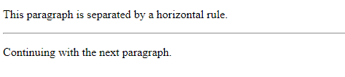
Text-level Elements
<hr> (Horizontal Rule):
The <hr> element inserts a horizontal line to separate content visually.
It gives spacing between blocks.
It is a self-closing element and does not have a closing tag.
<body>
<p>This paragraph is separated by a horizontal rule.</p>
<hr>
<p>Continuing with the next paragraph.</p>
</body>

Slide 27
Text-level Elements
<blockquote> (Block Quote):
The <blockquote> element represents a block of quoted content from another source.
Browsers typically indent and style blockquotes to distinguish them from regular text.
<body>
<blockquote>
<p>"Be yourself; everyone else is already taken." - Oscar Wilde</p>
</blockquote>
</body>

Slide 28

Text-level Elements
<figure> and <figcaption> (Figure with Caption):
The <figure> element:
Represents content referenced from main content, such as images or videos.
The <figcaption> element:
Adds a caption or description to the content inside <figure>.
<body>
<figure>
<img src="image.jpg" alt="A beautiful landscape">
<figcaption>A breathtaking landscape.</figcaption>
</figure>
</body>

Slide 29

HTML Lists

Slide 30
HTML Lists
Two types of lists:
Unordered lists (bulleted lists)
Created using the <ul> (unordered list) tag.
Ordered lists (numbered lists)
Created using the <ol> (ordered list) tag
List items are represented by the <li> (list item) tag.

Slide 31

HTML Lists
Unordered List (<ul>):
A list of items without any specific order or sequence.
Typically displayed as bullet points by default.
<ul> tag to create an unordered list
Individual list items inside the <li> tags.
<body>
<ul>
<li>Item 1</li>
<li>Item 2</li>
<li>Item 3</li>
</ul>
</body>

Slide 32


HTML Lists
Ordered List (<ol>):
Conversely, a list of items with a specific order or sequence
Typically displayed as bullet points by default.
<ol> tag to create an ordered list
Individual list items inside the <li> tags.
<body>
<ol>
<li>Item 1</li>
<li>Item 2</li>
<li>Item 3</li>
</ol>
</body>

Slide 33
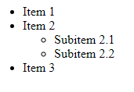
HTML Lists
Nested Lists:
Lists can be nested inside each other to create hierarchical structures.
<body>
<ul>
<li>Item 1</li>
<li>Item 2
<ul>
<li>Subitem 2.1</li>
<li>Subitem 2.2</li>
</ul>
</li>
<li>Item 3</li>
</ul>
</body>

Slide 34

HTML Forms

Slide 35

HTML Forms
Think for a website where you use form before and discuss the various types of form from different websites.
Approach for users to submit data to a web server for processing.
Essential for various interactive elements:
Contact forms
Login pages
Search bars

Slide 36
HTML Forms
The <form> element is used to create an HTML form.
Form elements:
Input fields
Buttons
Checkboxes
Radio buttons
The action attribute specifies the URL where the form data will be sent upon submission.
The method attribute defines the HTTP method used for the form submission (e.g., "GET" or "POST").

Slide 37

HTML Forms
<input>:
The <input> element represents various form controls like text input, radio buttons, checkboxes, buttons, etc.
The type attribute defines the type of input control to be displayed.
The name attribute is used to identify the input field when the form is submitted.
<form action="/submit" method="post">
<label for="username">Username:</label>
<input type="text" id="username" name="username">
<input type="submit" value="Submit">
</form>

Slide 38
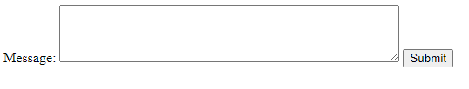
HTML Forms
<textarea>:
The <textarea> element creates a multi-line text input area for longer text entries.
The name attribute is used to identify the textarea when the form is submitted.
<form action="/submit" method="post">
<label for="message">Message:</label>
<textarea id="message" name="message" rows="4" cols="50"></textarea>
<input type="submit" value="Submit">
</form>

Slide 39

HTML Forms
<select> and <option>:
The <select> element creates a dropdown list, and <option> elements define the individual options in the list.
The name attribute is used to identify the select field when the form is submitted.
<form action="/submit" method="post">
<label for="country">Country:</label>
<select id="country" name="country">
<option value="USA">United States</option>
<option value="UK">United Kingdom</option>
<option value="Canada">Canada</option>
</select>
<input type="submit" value="Submit">
</form>

Slide 40

HTML Forms
<button>:
The <button> element represents a clickable button within the form.
It can be used for various purposes, such as submitting the form, triggering JavaScript functions, etc.
<form action="/submit" method="post">
<button type="submit">Submit</button>
</form>

Slide 41

HTML Forms
<fieldset> and <legend>:
The <fieldset> element groups related form elements together and creates a visual boundary around them.
The <legend> element provides a caption or label for the fieldset.
<form action="/submit" method="post">
<fieldset>
<legend>Contact Information</legend>
<label for="name">Name:</label>
<input type="text" id="name" name="name">
<label for="email">Email:</label>
<input type="email" id="email" name="email">
</fieldset>
<input type="submit" value="Submit">
</form>

Slide 42

HTML Forms
<input type="radio"> and <input type="checkbox">:
The <input type="radio"> element represents a radio button, allowing users to select one option from a group of options.
The <input type="checkbox"> element represents a checkbox, allowing users to select one or more options from a group of options.
<form action="/submit" method="post">
<label for="male">Male</label>
<input type="radio" id="male" name="gender" value="male">
<label for="female">Female</label>
<input type="radio" id="female" name="gender" value="female">
<br>
<label for="subscribe">Subscribe to Newsletter</label>
<input type="checkbox" id="subscribe" name="newsletter" value="subscribe">
<input type="submit" value="Submit">
</form>

Slide 43
HTML Best Practices
Use Semantic HTML:
Semantic elements (e.g., <header>, <nav>, <main>, <article>, <section>, <footer>).
Provides meaning to the structure of your web page. This improves accessibility and helps search engines understand the content.
Close Tags Properly:
Always close HTML tags.
Some elements are self-closing (e.g., <br> and <img>)
Some require closing tags (e.g., <p></p>).
Use Meaningful Text in Links and Buttons:
Provide descriptive link text and button labels that are meaningful.

Slide 44
HTML Best Practices
Lowercase Element Names and Attributes:
Use lowercase for HTML element names and attribute names.
Ensures consistency and better compatibility with XHTML and XML.
Accessibility:
Accessible to people with disabilities.
Use appropriate headings, labels for form elements, descriptive link text.
Valid and Well-Formatted HTML:
Ensure your HTML code is valid.
Adhering to the HTML standard.
Use proper indentation and formatting to enhance readability for both humans and machines.

Slide 45
HTML Best Practices
Test Cross-Browser Compatibility:
Test web pages on different browsers (Chrome, Firefox, Safari, Edge, etc.).
Ensure they display and function correctly across platforms.
Avoid Deprecated Elements:
Avoid using deprecated HTML elements and attributes.
Check the current HTML specifications to ensure usage of the latest and recommended elements.
Mobile Responsiveness:
Design your web pages to be mobile-responsive
Adjust layout and content to different screen sizes and devices

Slide 46
Quiz - 1
1. What is the correct order of elements in a basic HTML document structure?
A) <body>, <head>, <html>
B) <head>, <html>, <body>
C) <html>, <head>, <body>
D) <html>, <body>, <head>
2. Which HTML element is used to define the metadata of the document, such as its title and character set?
A) <body>
B) <header>
C) <meta>
D) <head>
3. What is the purpose of the <!DOCTYPE html> declaration?
A) It links the HTML document to a CSS file.
B) It declares the document type and version of HTML.
C) It includes JavaScript code in the HTML document.
D) It adds a title to the HTML document.
Notes:
Correct Answer: C) <html>, <head>, <body>
Correct Answer: D) <head>
Correct Answer: B) It declares the document type and version of HTML.

Slide 47
Quiz - 2
1. Which element is used to define emphasized text in HTML?
A) <strong>
B) <em>
C) <mark>
D) <i>
2. What is the purpose of the <br> element in HTML?
A) To create a new paragraph
B) To insert a horizontal line
C) To add a line break within a text
D) To emphasize text
3. Which HTML element is used to define a part of text in an alternate voice or mood?
A) <blockquote>
B) <cite>
C) <q>
D) <s>
Notes:
Correct Answer: B) <em>
Correct Answer: C) To add a line break within a text
Correct Answer: C) <q>

Slide 48
Quiz - 3
1. What is the purpose of the <form> element in HTML?
A) To create a searchable database
B) To display user inputs
C) To collect user inputs
D) To format document sections
2. Which attribute specifies the method the form data should be sent to the server?
A) method
B) action
C) type
D) enctype
3. What type of form input is used to submit the form to the server?
A) <input type="text">
B) <input type="submit">
C) <input type="button">
D) <input type="checkbox">
Notes:
Correct Answer: C) To collect user inputs
Correct Answer: A) method
Correct Answer: B) <input type="submit">

Slide 49
References
Introduction to HTML:
Mozilla Developer Network (MDN). (n.d.). Introduction to HTML. Available at: https://developer.mozilla.org/en-US/docs/Learn/HTML/Introduction_to_HTML
HTML Document Structure:
Mozilla Developer Network (MDN). (n.d.). Getting started with HTML. Available at: https://developer.mozilla.org/en-US/docs/Learn/HTML/Introduction_to_HTML/Getting_started
HTML Text Level Elements:
Mozilla Developer Network (MDN). (n.d.). HTML basics. Available at: https://developer.mozilla.org/en-US/docs/Learn/HTML/Introduction_to_HTML/HTML_basics

Slide 50
Topic 2 – Introduction to HTML5
Any Questions?
Notes:
NCC Education - End Slide Master

